Slide 1

Green Pace
Security Policy Presentation
Developer: Devin Widmer

Slide 2

OVERVIEW: DEFENSE IN DEPTH
This model illustrates the detailed methods used in Defense in Depth and how they will be implemented into the security policy to ensure secure coding is achieved.

Slide 3
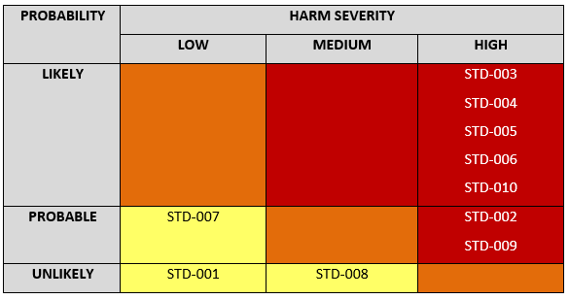
THREATS MATRIX
Secure Coding
standards come
with certain
levels of
vulnerability to
measure the
impact of that
certain
standard. Here
is a chart to
prioritize those
levels.

Slide 4
10 PRINCIPLES
Validate Input Data
Heed Compiler Warnings
Architect and Design for Security Policies
Keep it Simple
Default Deny
Adhere to the Principle of Least Privilege
Sanitize Data Sent to Other Systems
Practice Defense in Depth
Use Effective Quality Assurance Techniques
Adopt a Secure Coding Standard

Slide 5
CODING STANDARDS
Declare all variables, functions and return types prior to using them. Do not accept implicit declarations.
Do not read uninitialized variables.
Verify that the string storage has adequate space for null terminator.
Always use prepared statements for querying.
Do not access freed memory.
Use assertions to test assumptions such as if a pointer is NULL or not. If the expression evaluates to false, the abort() function is called preventing unexpected behavior.
Handle all exceptions.
Close files when they are no longer needed.
Use valid iterator ranges.
Ensure that operations on signed integers do not result in overflow.

Slide 6
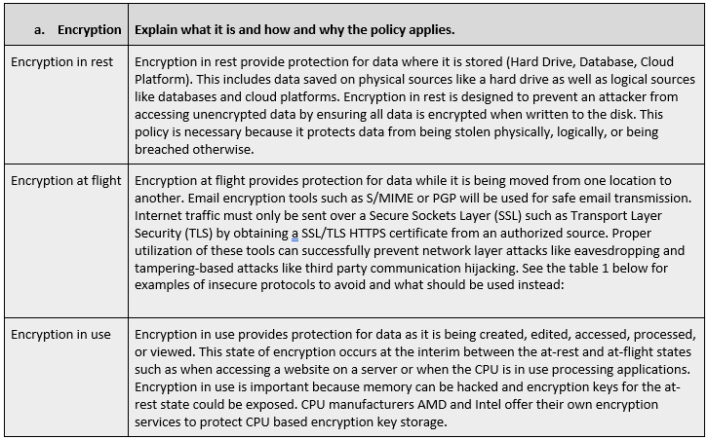
ENCRYPTION POLICIES

Slide 7
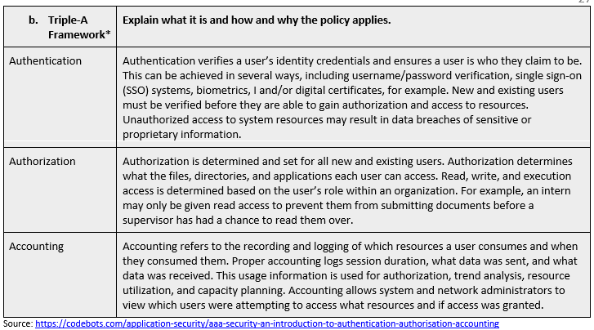
TRIPLE-A POLICIES

Slide 8
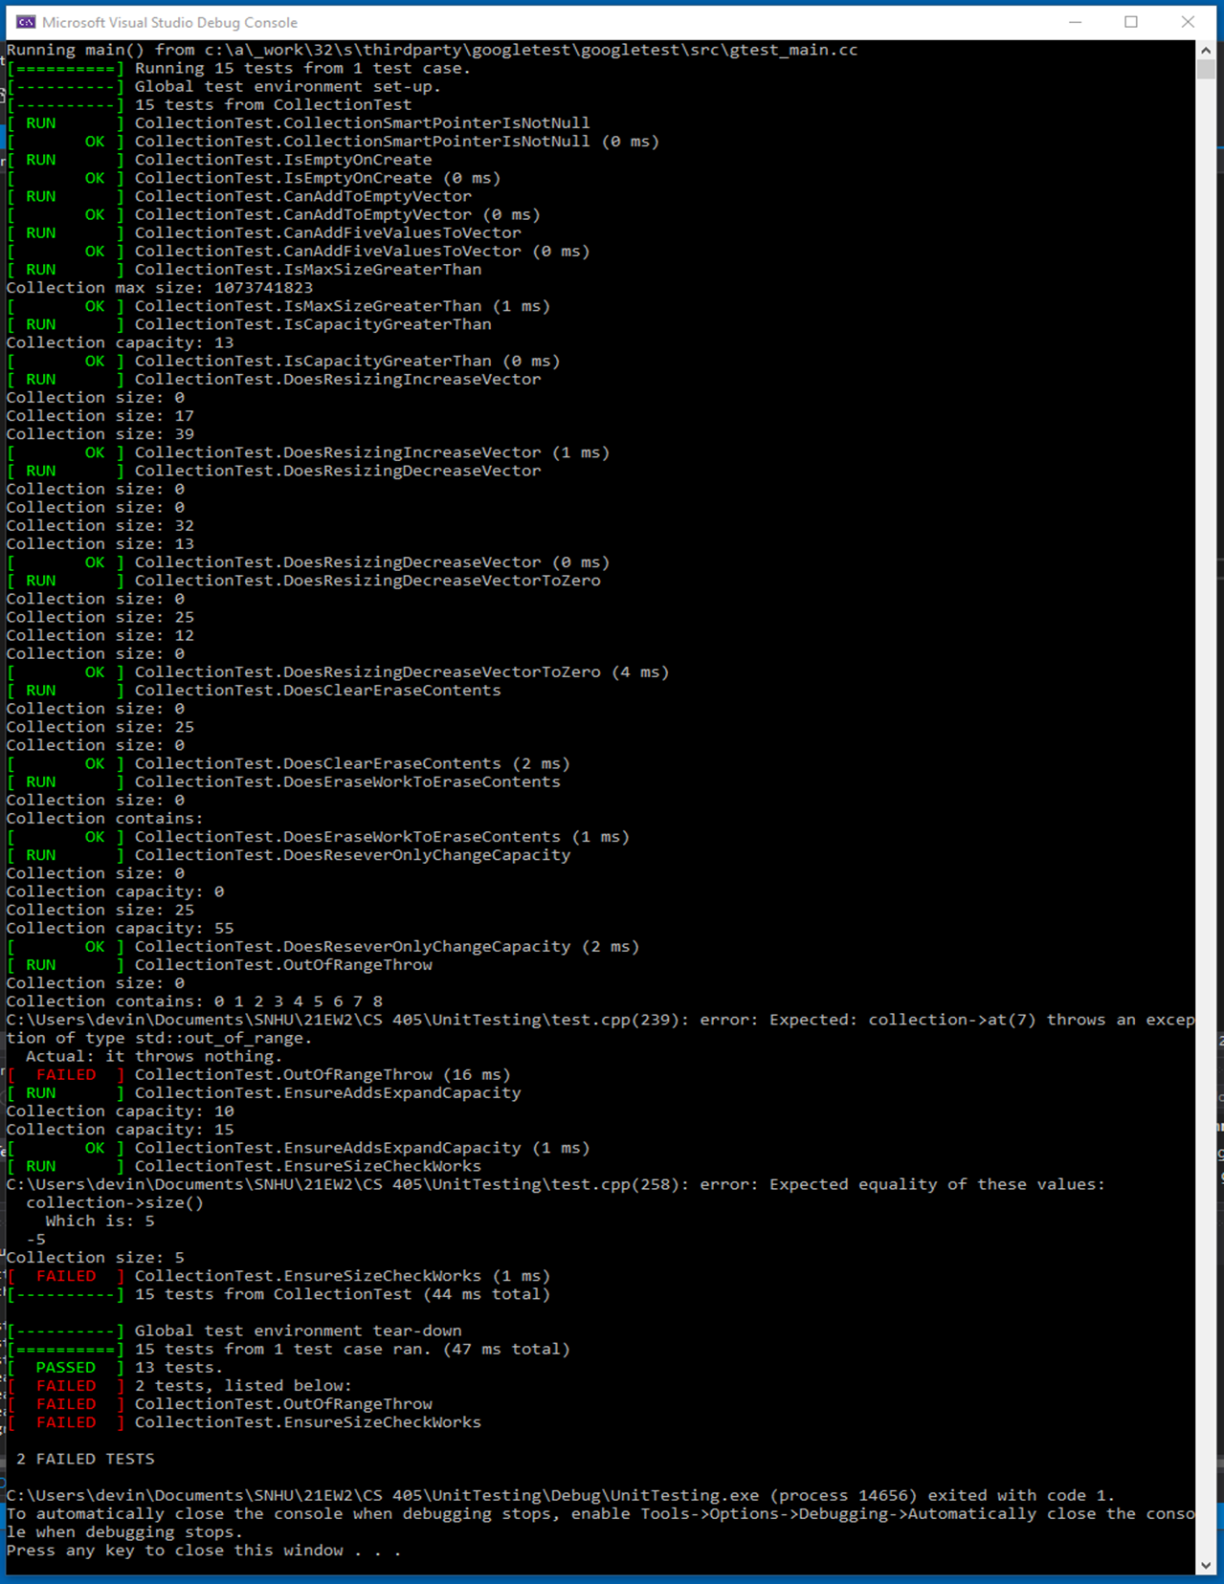
Unit Testing
Our unit test practices
come early and often
through out the
development process to
ensure that we have
secure functioning code.
For Example, Limiting the number of
characters within a user
input string to prevent
buffer overflow

Slide 9

AUTOMATION SUMMARY

Slide 10
TOOLS
DevOps becomes DevSecOps by integrating security protocols into each step of the DevOps toolchain. In the pre-production phases, threat modeling and security tool selections and training are implemented into the “Assess and Plan” segment. During the Design and Build phases, proper IDE security is addressed and implemented. Also, automated security scans and static application testing are implemented in the Verify and Test phase in addition to unit, integration and other types of testing.
Once the production phase has been entered, automated testing with prevention by utilizing integrity checks and defense-in-depth measures. Network monitoring, penetration testing, and performance logs are all methods of continuous threat detection. Much like testing for QA purposes, testing for security purposes should also be performed early and often.

Slide 11
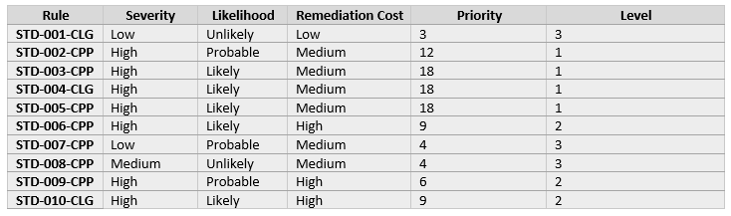
RISKS AND BENEFITS
The protection of software code is no longer an option in today’s world of cybercrimes – it is mandatory.
The benefits of testing early and often far outweigh the negative consequences of neglecting to follow this security policy, the coding standards, and secure coding best practices

Slide 12
RECOMMENDATIONS
Enforcing this security policy is absolutely critical to limiting security vulnerabilities going forward.
As new potential security threats are identified, it’s important to regularly review and update the security policy to make sure it reflects the most current information needed to ensure security.

Slide 13
CONCLUSIONS
Developing a secure coding practices and a strong security policy is not a one-time thing. This security should be reviewed and updated at least once a year or when new security threats have been identified.
While the coding standards in this security policy provide a good start, additional coding standards should be added to ensure compliance with all ten principles.
By following secure coding standards from the start of development, utilizing defense in depth, and implementing daily testing routines, DevOps will become DevSecOps for Green Pace.

Slide 14
REFERENCES
Seacord, R. (2018, May 2). Top 10 Secure Coding Practices. Top 10 Secure Coding Practices - CERT Secure Coding - Confluence. Retrieved December 12, 2021, from https://wiki.sei.cmu.edu/confluence/display/seccode/Top+10+Secure+Coding+Practices.
Mylonas, L. (2018, November 27). What is AAA Security? an introduction to authentication, Authorisation and Accounting. Codebots. Retrieved December 12, 2021, from https://codebots.com/application-security/aaa-security-an-introduction-to-authentication-authorisation-accounting.

